Slide 1
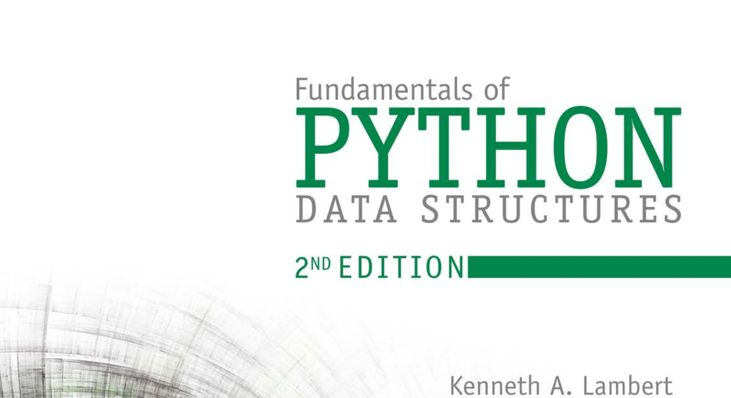
Database Systems: Design, Implementation, and Management 14th Edition
Chapter 1
Database Systems

Slide 2


National Economics University Faculty of Data Science & Artificial Intelligence
DATA STRUCTURES AND ALGORITHMS: Queue
Instructor: Duc Minh Vu (FDA – SLSCM Lab)
Email: minhvd [at] neu.edu.vn
12/19/2024
Data Structures and Algorithms in Python
2

Slide 3
Learning Objectives
Describe the features of a queue and the operations on it
Choose a queue implementation based on its performance characteristics
Recognize applications where it is appropriate to use a queue
Explain the difference between a queue and a priority queue
Recognize applications where it is appropriate to use a priority queue

Slide 4
Overview of Queues
Queues are linear collections in which insertions are restricted to one end, called the rear, and removals to the other end, called the front.
Insert an element to a collection – this new element becomes rear.
Remove the oldest element in the collection (the front), the next oldest one becomes front
Adhere to a first-in first-out (FIFO) protocol.
The operations for putting items on and removing items from a queue are called push/add/enqueue and pop/dequeue.

Slide 5
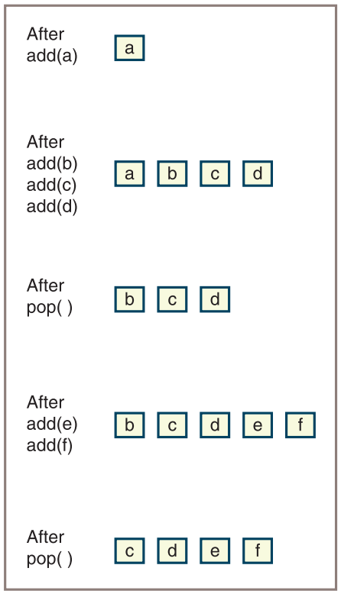

Initially, the queue is empty. Then an item called a is added. Next, three more items called b, c, and d are added, after which an item is popped, and so forth

Slide 6
Some applications
Translating infix expressions to postfix form and evaluating postfix expressions.
CPU access—Processes are queued for access to a shared CPU.
Disk access—Processes are queued for access to a shared secondary storage device.
Printer access—Print jobs are queued for access to a shared laser printer.

Slide 7
The Queue Interface and Its Use
The Queue Interface
push/add, pop, peek and other basic methods
peek = examine the top element but not pop
Instantiating a Queue
q1 = ArrayQueue() # Create empty array queue
q2 = LinkedQueue([3, 6, 0]) # Create linked queue with given items

Slide 8
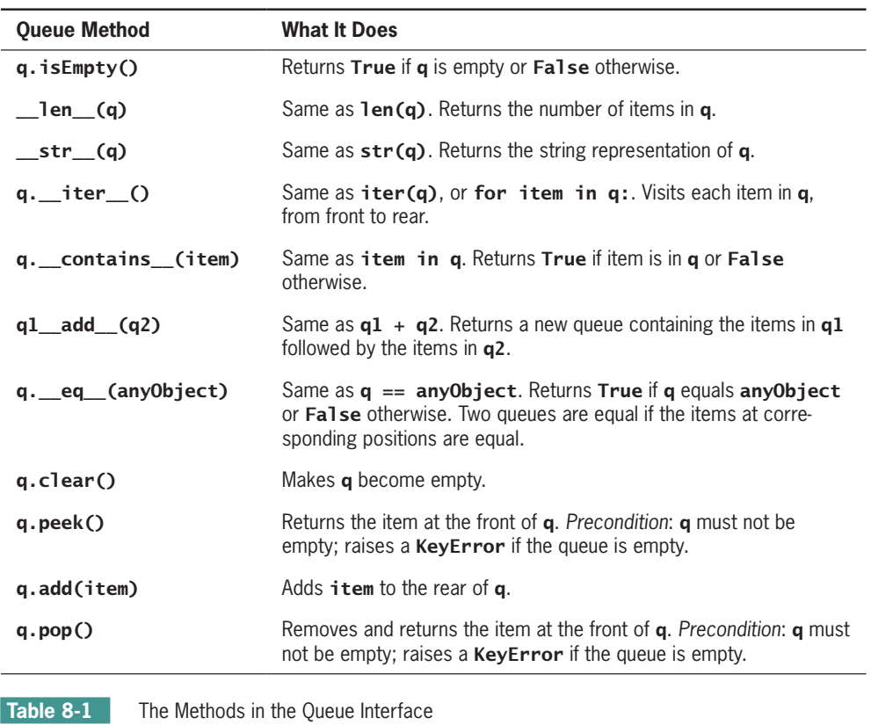

Slide 9
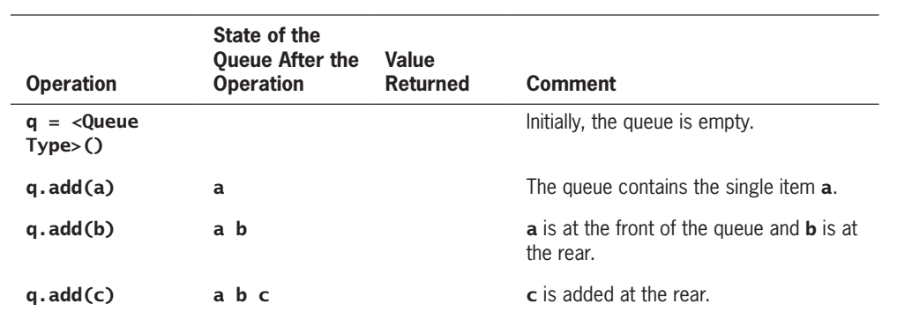

Slide 10
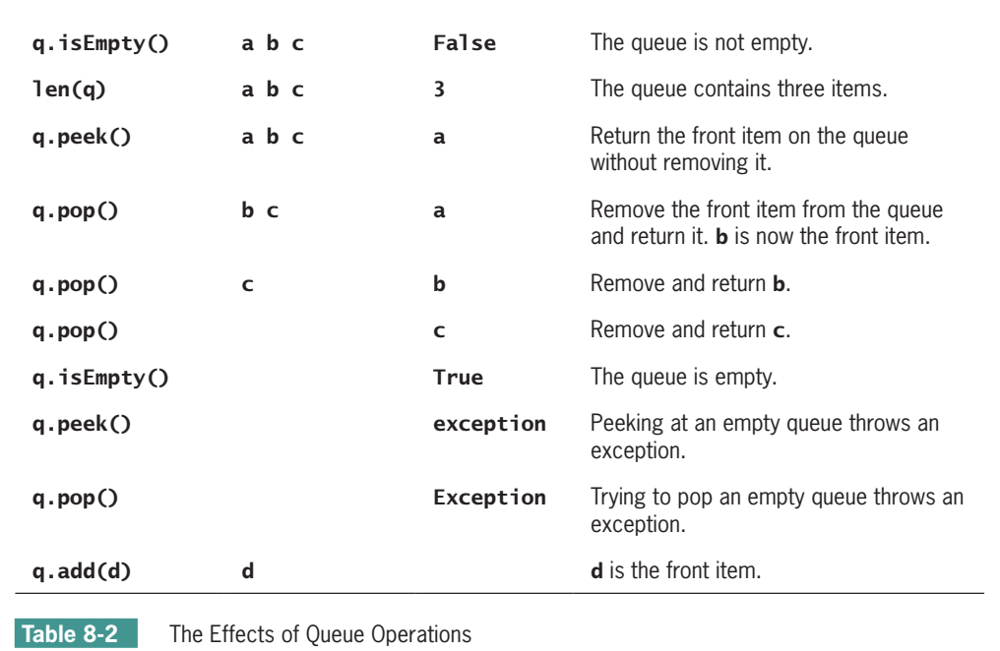

Slide 11
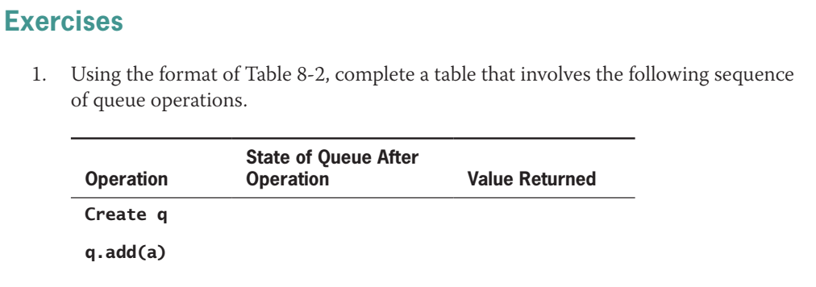

Slide 12
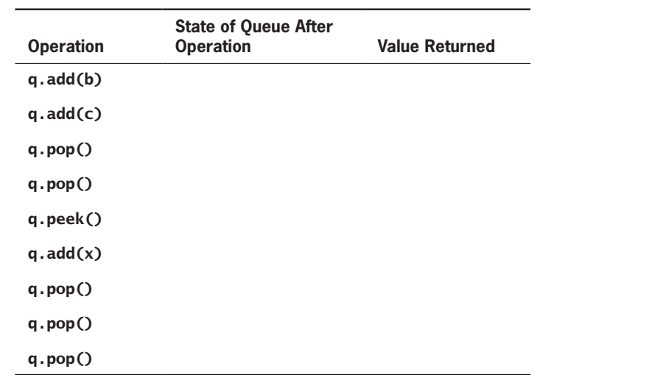

Slide 13
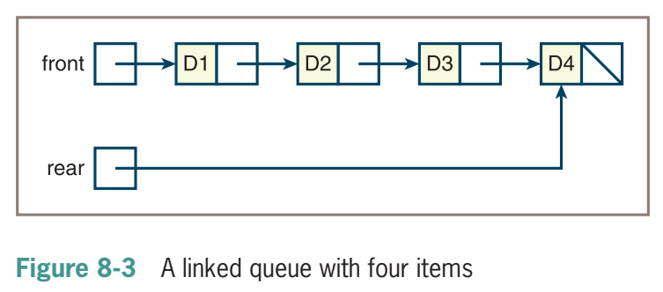
A Linked Implementation of Queues
The operation push adds a node at the head of the sequence, whereas add adds a node at the tai

Slide 14
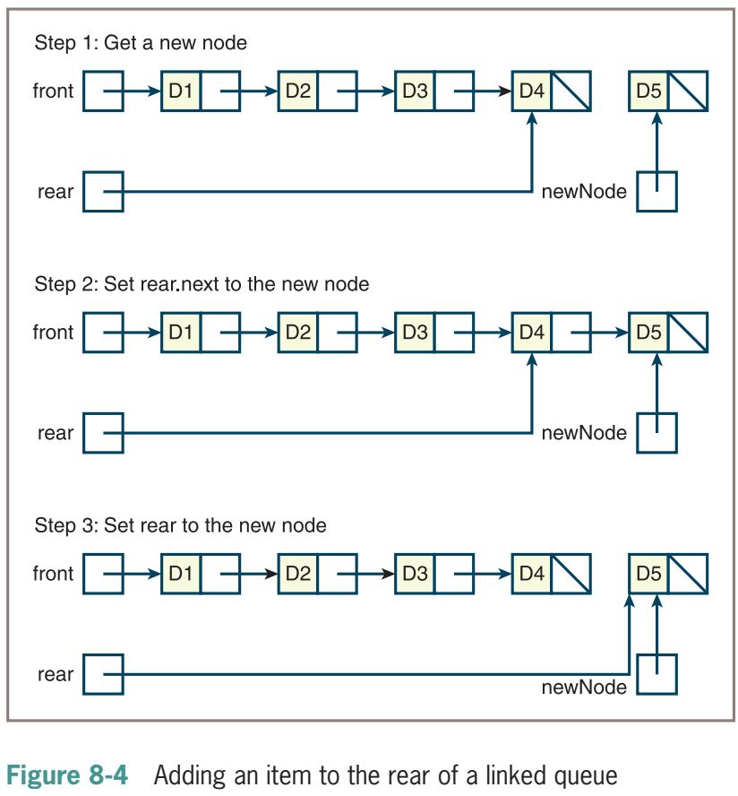
During an add operation, create a new node, set the next pointer of the last node to the new node, and set the variable rear to the new node, as shown in Figure 8-4.

Slide 15
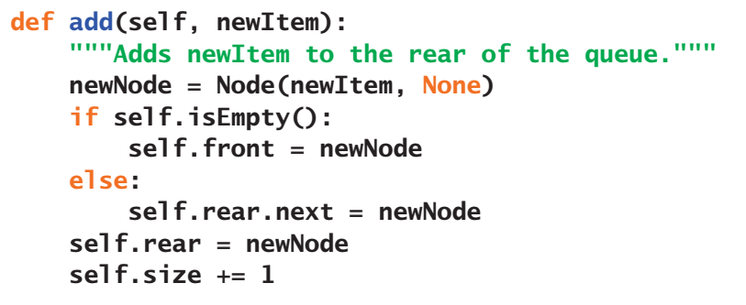

Slide 16
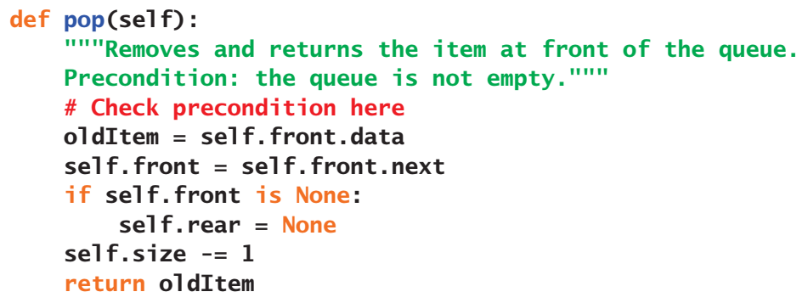

Slide 17
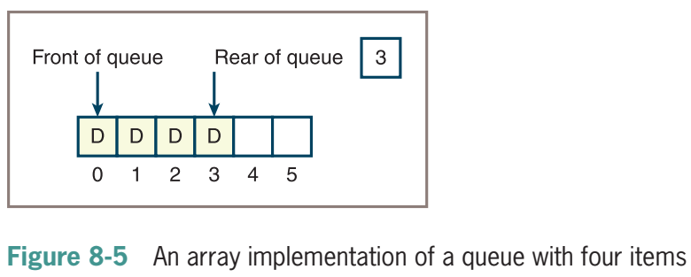
An Array Implementation
The first attempt at implementing a queue fixes the front of the queue at index position 0 and maintains an index variable, called rear, that points to the last item at position n - 1 where n is the number of items in the queue.

Slide 18
An Array Implementation
The first attempt at implementing a queue fixes the front of the queue at index position 0 and maintains an index variable, called rear, that points to the last item at position n - 1 where n is the number of items in the queue.

Slide 19
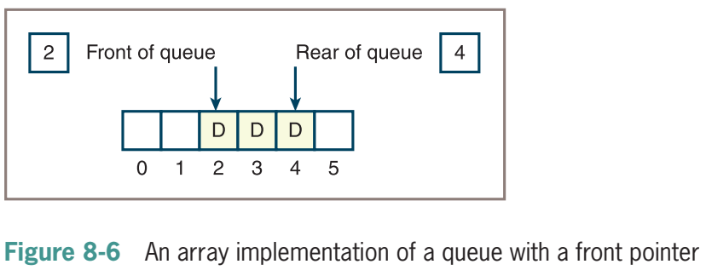
An Array Implementation
Second Attempt: The front pointer starts at 0 and advances through the array as items are popped.

Slide 20
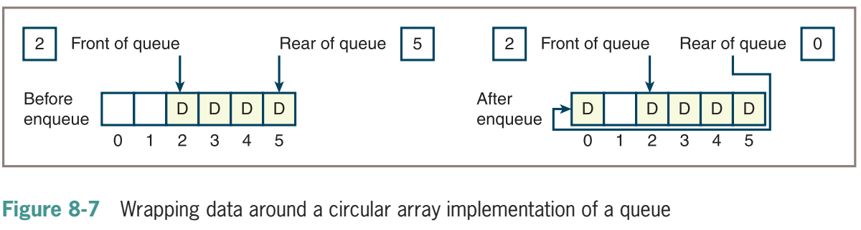
An Array Implementation
Third Attempt: By using a circular array implementation, you can simultaneously achieve good running times for both add and pop.

Slide 21
Time and Space Analysis for the Two Implementations
Linked implementation of queues
The running time of the __str__, __add__, and __eq__ methods is O(n)
Running time of all the other methods is O(1)
Circular array implementation of queues:
If the array is static, the maximum running time of all methods other than __str__, __add__, and __eq__ is O(1)
If the array is dynamic, add and pop jump to O(n) anytime the array is resized but retain an average running time of O(1)

Slide 22
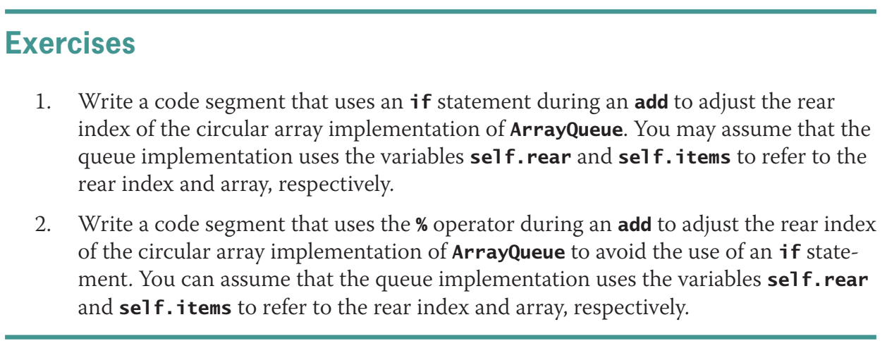
Complexity: O(n) for postfix evaluation

Slide 23
Priority Queues
a specialized type of queue.
When items are added to a priority queue, they are assigned an order of rank.
When they are removed, items of higher priority are removed before those of lower priority.
Queue and Priority Queue have the same interface or set of operations (see Table 8-1)

Slide 24
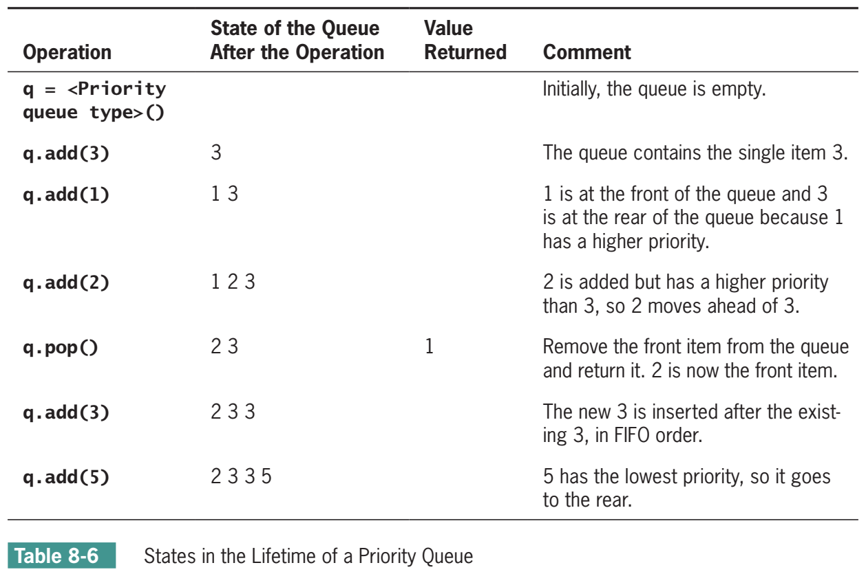

Slide 25
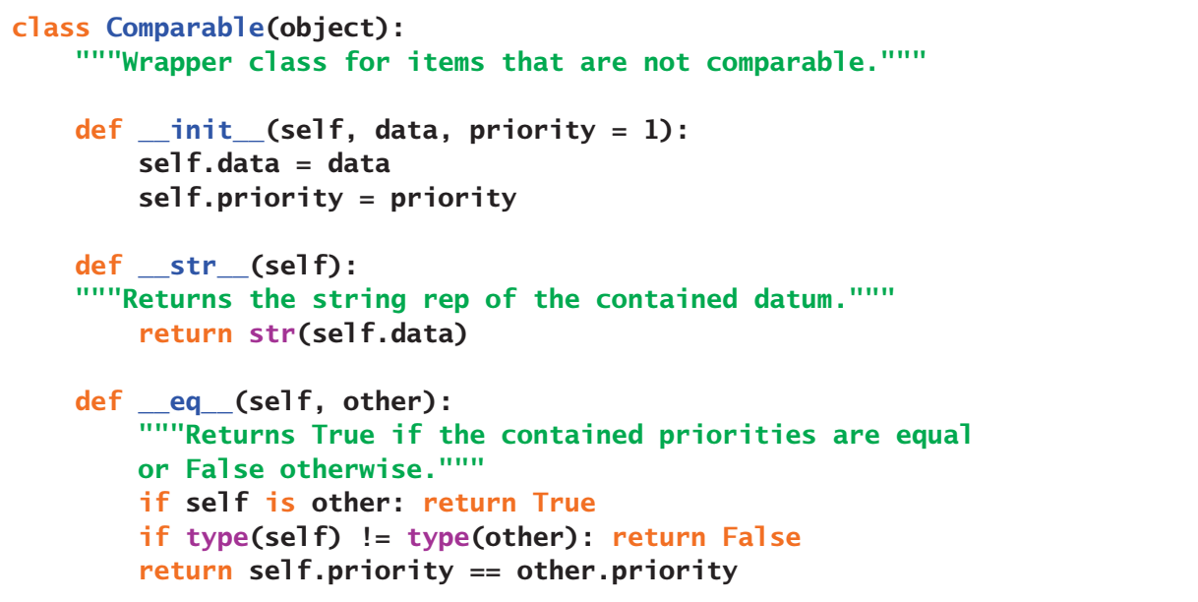
E.g. we want to rank complex numbers by its magnitude/absolute value
Priority = those values

Slide 26
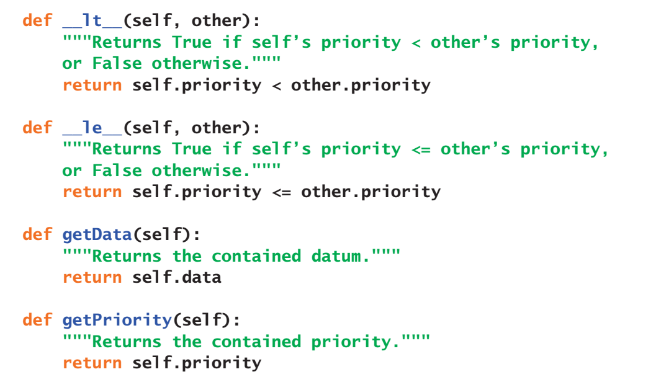

Slide 27
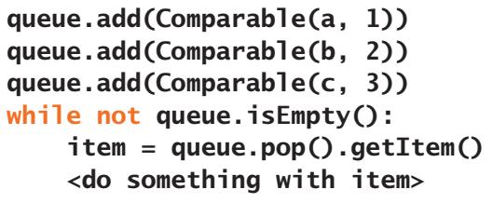

Slide 28
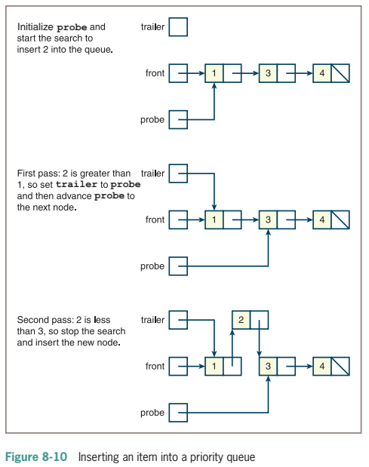

Slide 29
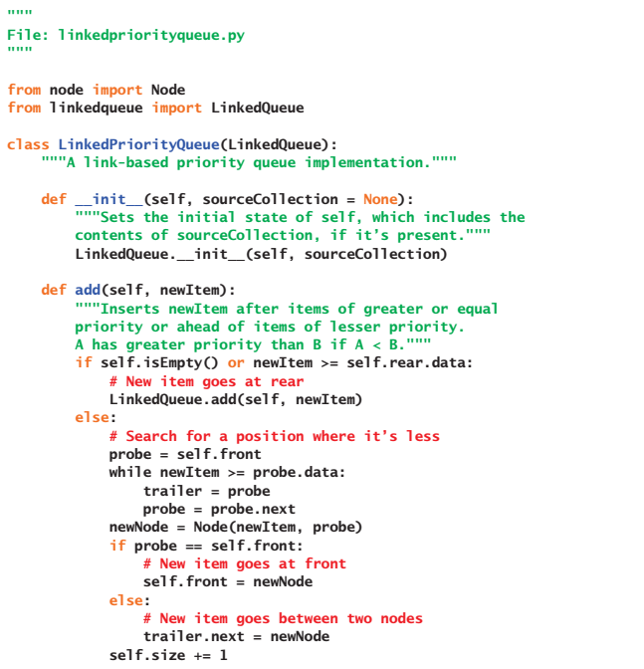

Slide 30
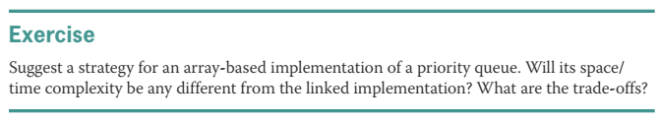

Slide 31
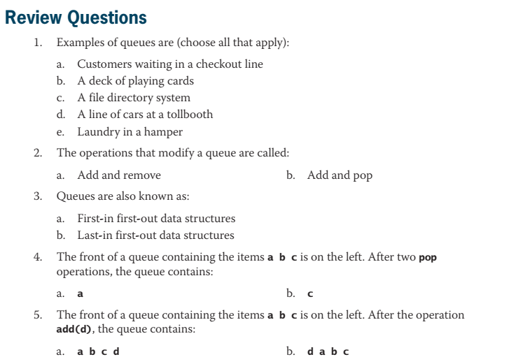

Slide 32
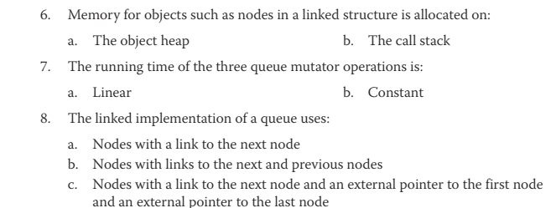

Slide 33
